Slide 1
Final Project
Option A
Avni Kothari, Sarah Luna, Khurram Jiwani

Slide 2
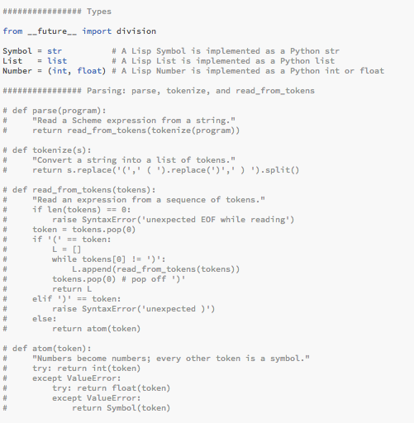
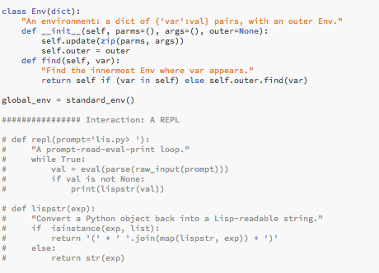
Code that was not being used

Slide 3
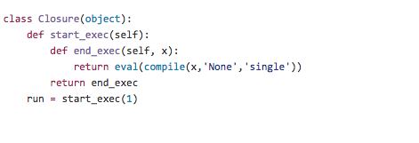
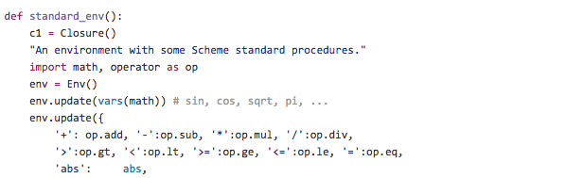
Python Closures
Notes:
Use some time to explain how this was done

Slide 4
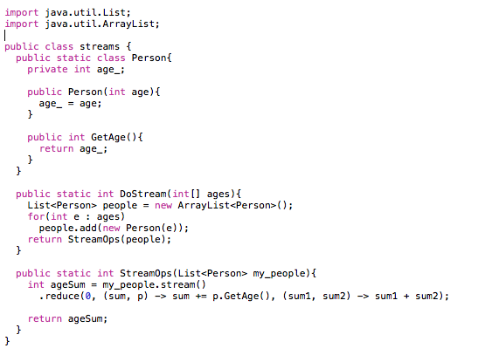
Java Stream Operations
Java file with
Stream operations
Input list
Notes:
The Java code was modified to take in a list and add each element in the list. The list is then passed through the stream operation in order to do a simple addition

Slide 5


List Comprehension
Takes in a list and squares it
Sorts the list by value
Notes:
Remarks on list comprehension implementation

Slide 6
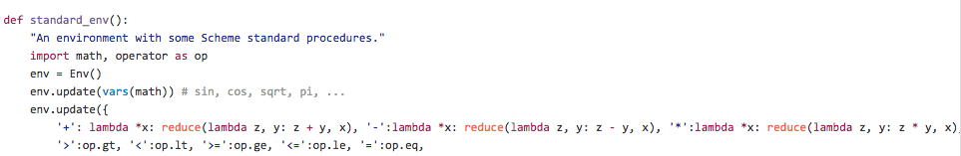
Errors found and corrected
The code could not handle more than 2 arguments
Notes:
How did we find the errors?
How did we fix them?
Other errors that we didn’t know how to fix? Ideas to fix them?

Slide 7

Errors found and corrected
The code could not handle sin and cos
Notes:
How did we find the errors?
How did we fix them?
Other errors that we didn’t know how to fix? Ideas to fix them?

Slide 8
Errors found and corrected
The code did not properly handle IF statements
The code did not properly handle negations
Notes:
How did we find the errors?
How did we fix them?
Other errors that we didn’t know how to fix? Ideas to fix them?

Slide 9
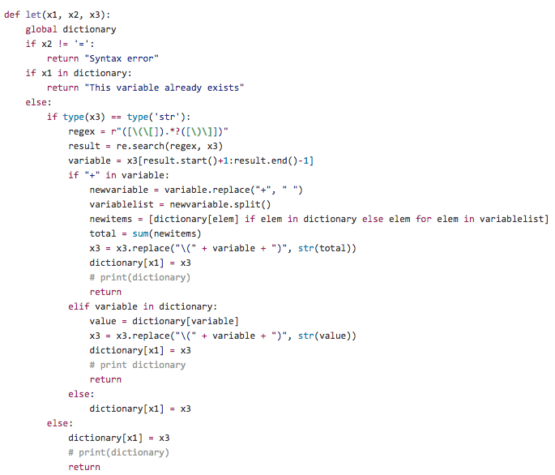
Swift
Notes:
Discuss Swift Implementation *******WITH DEMO********

Slide 10
Implementation of the Exec function
Multiplication
Addition
Square root
Notes:
******THIS WILL BE A DEMO******
LIST OF INPUTS (WORKS IN JAVA STREAM FILE):
(exec 'import Multiplication; toReturn = Multiplication.multiply(5, 10)')
(exec 'import SquareRoot; toReturn = SquareRoot.square(100)')
(+ 1 (exec 'import Addition; toReturn = Addition.add(23, 34)'))

Slide 11
Challenges
Accomplishments
Getting the Swift Parser to recognize the correct syntax and add variables
Passing in a list to Java to use Stream operations while using the exec function
List comprehension
Closures
Cleaning up code was straight forward

Slide 12
Final Remarks
Applying what we learned all semester to accomplish the requirements of the project - closures, list comprehension, stream operations, etc.
Learning more about regular expressions
Creativity (lack of instructions was frustrating at first but made us accomplish the code in creative ways)
If we had more time, there are a couple of things we would have done differently...
Creating tokens for the parenthesis - more effective
Java streams - handling both ints and string

Slide 13
You’ve got questions?
We’ve got answers! (Hopefully)

